Slide 1
ICIP Feedback
Presenter: Kim Seung Hwan (overnap@khu.ac.kr)

Slide 2
What I learned from the reviews
Reviewers may misunderstand the topic or may not be interested in
Reviewers care about performance in numbers
The most critical reviews misunderstood my claim
And pointed out poor performance

Slide 3
Clear Intro & contribution
Write so that even someone unfamiliar with the topic can easily read it
Indeed, I found my introduction to be lengthy to explain motivation
It seems best to present a clear contribution in the introduction
And leave the background as much as possible after

Slide 4
Structure of Writing
I wrote assuming that the reader would read everything in order
So, although the explanation may have been sufficient, it lacks structure
This makes it more likely one will misunderstand the content
Like the reviewer did…
This becomes even more of a problem when the reader skims through excerpts

Slide 5
Structure of Writing
I do not think there is much of a deficiency in terms of content
Therefore, I plan to keep the content as is but change the structure

Slide 6
ICIP Submission Summary
Problems and solutions that arise because beta and sigma are different
1. The Introduction with some background to explain the motivation
2. beta and sigma were designed for different purposes
3. Issues that arise when they are considered the same, analyzed mathematically
4. When this is implemented, the results are as expected
5. Proper separation is required to obtain healthy results

Slide 7
ICIP Submission Summary
Problems and solutions that arise because beta and sigma are different
1. The Introduction with some background to explain the motivation
2. beta and sigma were designed for different purposes
3. Issues that arise when they are considered the same, analyzed mathematically
4. When this is implemented, the results are as expected
5. Proper separation is required to obtain healthy results
What is the right way?

Slide 8
Add Motivation
There are two blur issue in VAE
- Blurry because sampling is not good
- Blurry because decoder variance is large
There are other structural problems as well,
But we will only look at two here

Slide 9

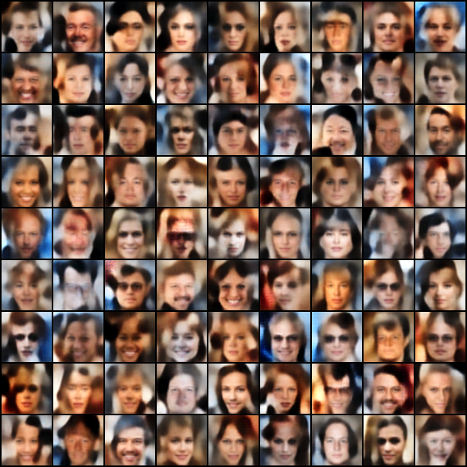
Add Motivation
Model is well optimized, has high likelihood
But the sampling is bad; Cannot be solved with likelihood alone
Need to introduce beta

Slide 10
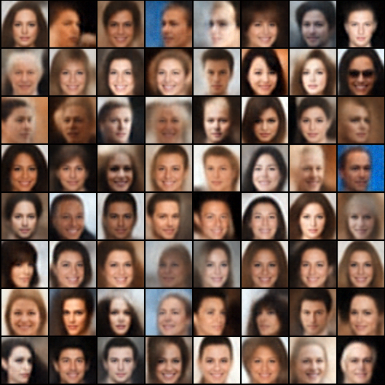
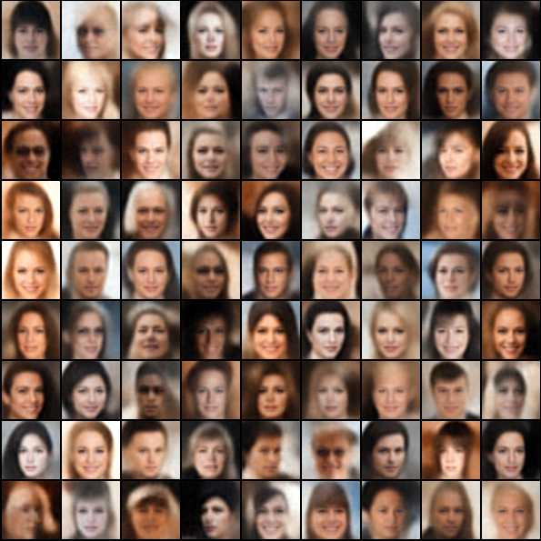
Add Motivation
Decoder variance is large
The likelihood is not well optimized in the first place

Slide 11


Add Motivation
Very extreme case
The likelihood is incredibly high, but what about sampling?

Slide 12
Add Result
The previous experiment was an experiment that compared the baseline and my claim
I thought this was good enough for a proof of concept,
But the reviewer pointed out the performance itself
I would like to add quantitative experiments to compare performance
Performance comparison of deep VAE based on my claim & various deep generative models

Slide 13
Structure in Mind
Problems and solutions that arise because beta and sigma are different
1. A brief Introduction with well-organized contributions
2. Two pathological blur in VAE (Added!)
3. beta and sigma were designed for different purposes
- the differences between beta and sigma to deal with each case of blur (Added!)
- Conceptual explanation of existing writing
4. Issues that arise when they are considered the same, analyzed mathematically
5. When this is implemented, the results are as expected (existing proof-of-concept experiments)
6. Proper separation is required to obtain healthy results
7. Evaluation of deep networks for performance evaluation (Added! quantitative experiments)

Slide 14
Side Idea 1
I found that the mathematical proof of the two-stage VAE, which used to solve the sampling problem, can be applied to beta-VAE
So what if one reduce the beta only in the front VAE?
Can the quality be improved but sampling remain the same?
I tried the experiment, but the 2nd stage VAE itself is not working well

Slide 15
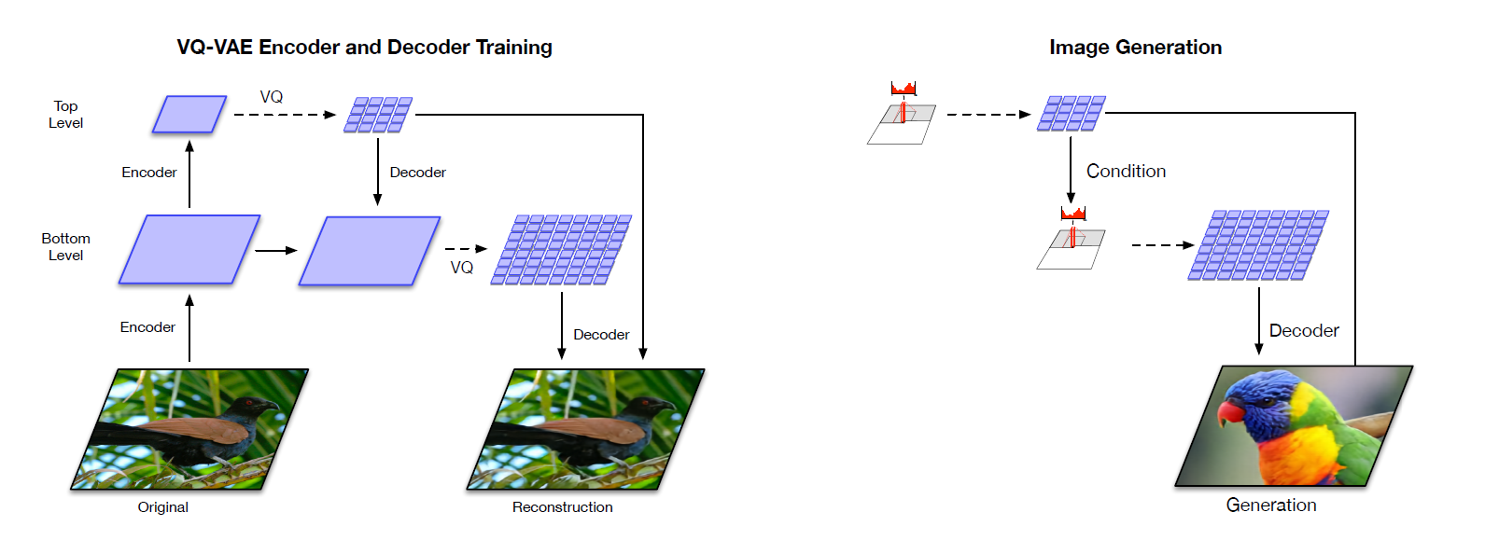
Side Idea 2
The previously mentioned Unet structure VAE
Sequential Structure vs. Full covariance relationship

Slide 16
Side Idea
If the side idea goes well, the research can be expanded to solve
Not only the beta and sigma one
in blurring problems of VAE described above,
But also various structural problems

Slide 17

Thank you for listening
Presenter: Kim Seung Hwan (overnap@khu.ac.kr)

